Slide 1


East Creek Operational Plan Summary
2000-2028

Slide 2
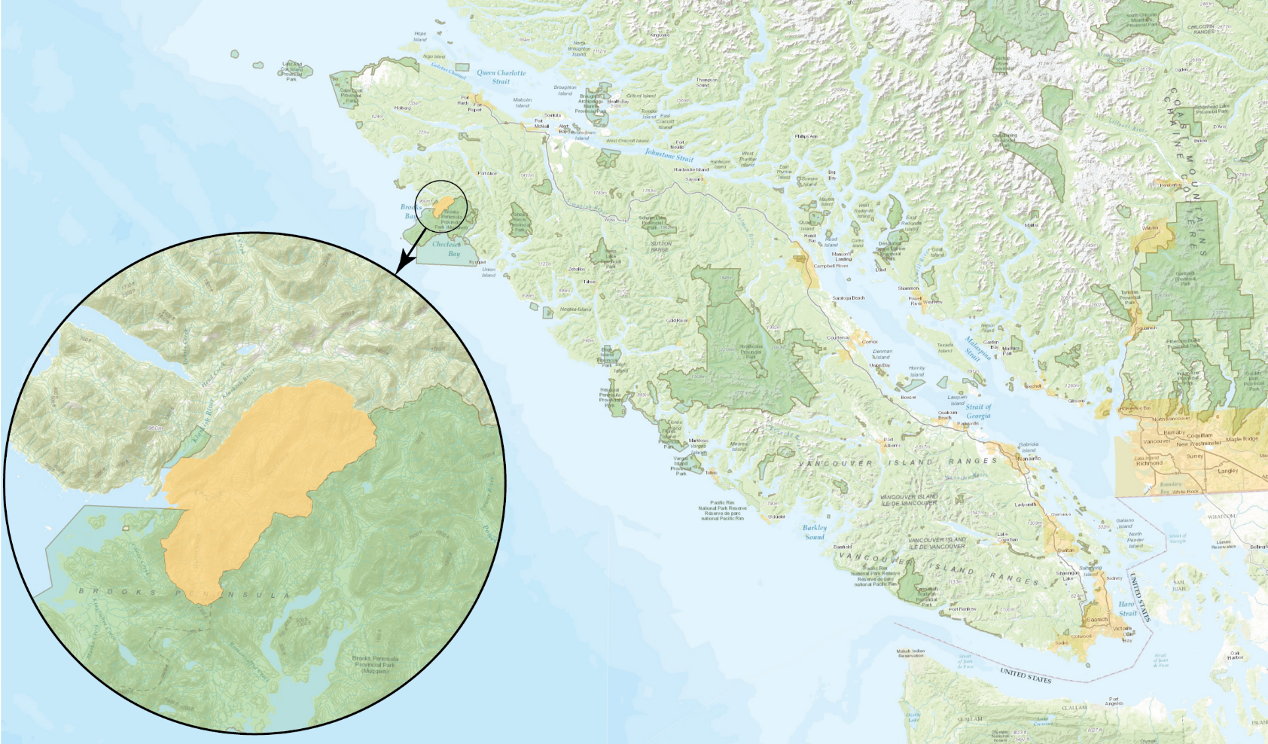

Slide 3

2003

Slide 4

2008

Slide 5

2016

Slide 6

2028

